Slide 1
Constructing pie charts
Graphical representations of data

Slide 2
how to use Oak lessons

Slide 3
I can construct pie charts from data.

Slide 4
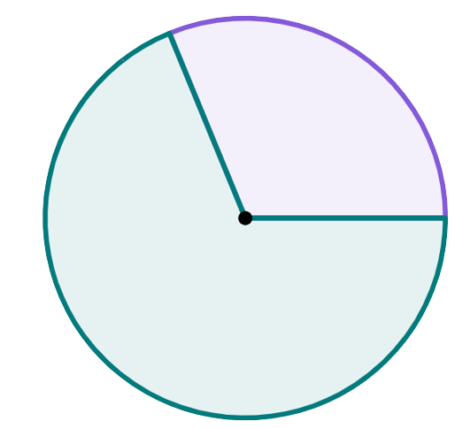
A sector is the region formed between two radii and their connecting arc.
sector
sector
radius

Slide 5
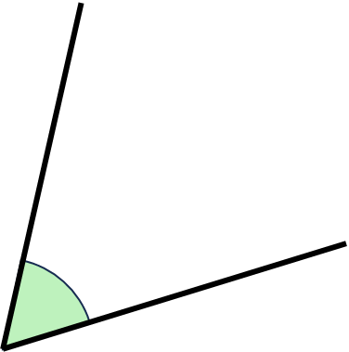
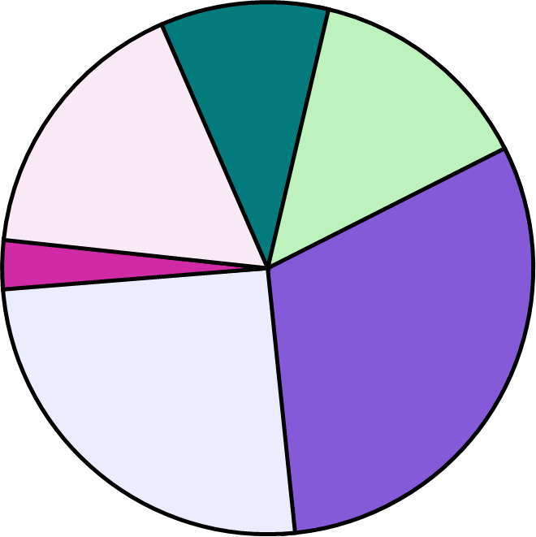
An angle is a measure of turn, it is often displayed as the rotation between two line segments.
angle
A pie chart (pie graph) is a circular graph where sectors represent different groups proportionally.
The frequency is the number of times an event occurs; or the number of individuals (people, animals etc.) with some specific property.
Degrees are the most common unit of measurement for angle. One whole turn is equal to 360 degrees, written 360°

Slide 6

Constructing pie charts
Introduction to pie charts
Calculating angles for pie charts
Constructing pie charts

Slide 7
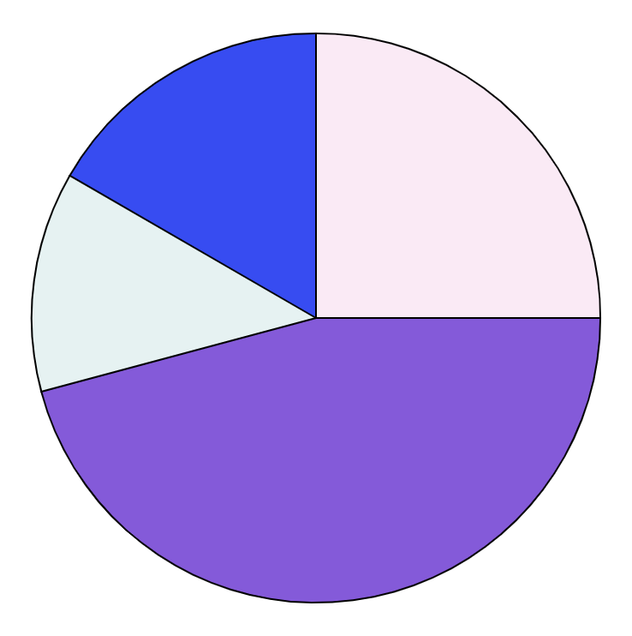
Introduction to pie charts
This is a pie chart.
But what is the purpose of a pie chart? What does it represent?
sector C
sector D
The whole pie chart represents the total frequency (or amount), everything in the dataset.
sector B
sector A
The size of each sector is proportional to the frequency (or value) of the group/category it represents - the bigger the sector, the higher the frequency (or amount).

Slide 8
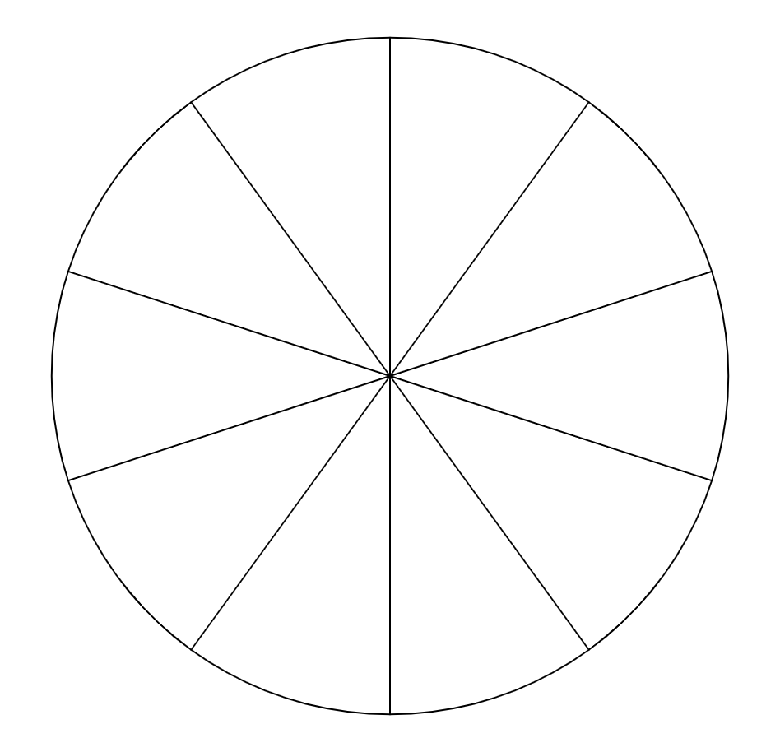
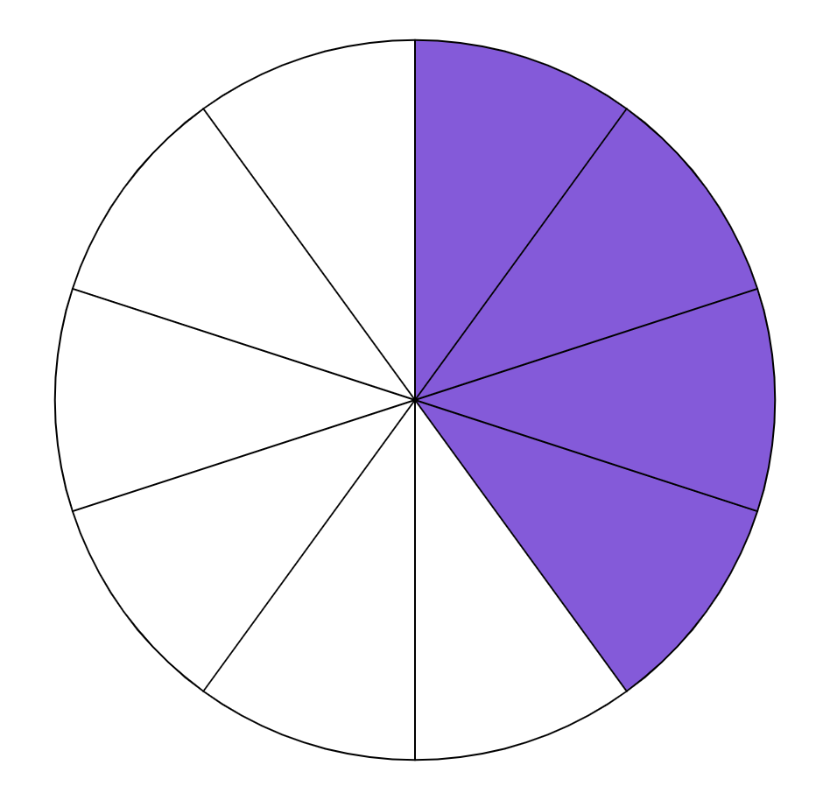
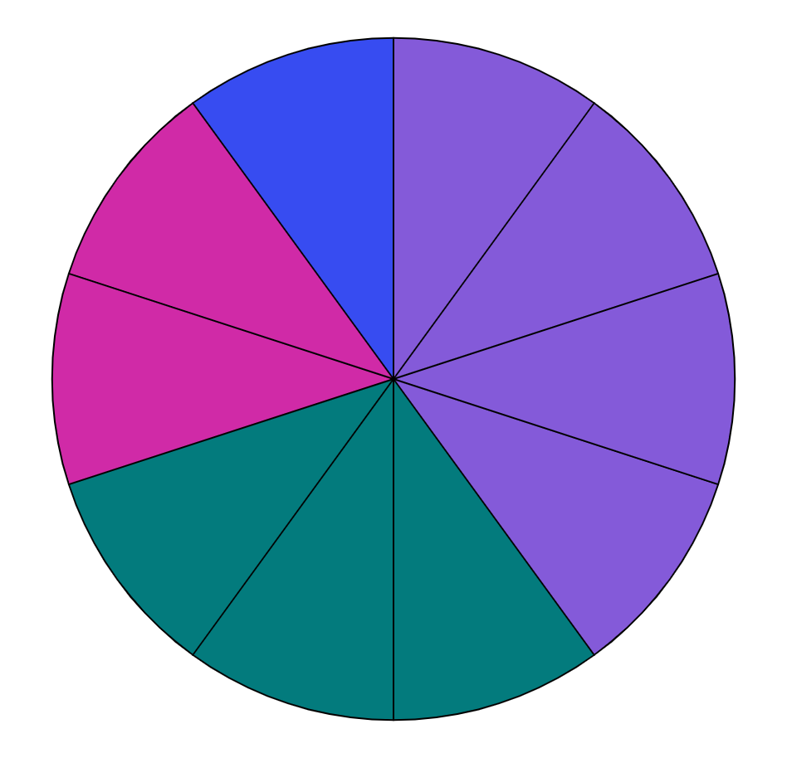
Introduction to pie charts
A teacher asked a class of 10 students what their favourite colour was. These were the results.
blue
purple
pink
purple
purple
purple
purple
purple
pink
purple
green
purple
green
green
green
green
green
pink
pink
blue
How many sectors should the teacher fill in purple?
The teacher then created a pie chart, split into 10 sectors, to visually represent this data.
4 sectors, because 4 people chose purple.

Slide 9


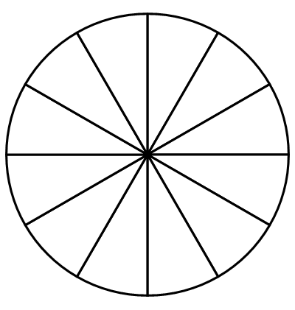
Introduction to pie charts
If the frequency of the data and the number of sectors in the pie chart are different, you have to use proportional reasoning to find out how many pieces of data go into one sector!
colour | frequency
purple | 45
green | 30
pink | 90
blue | 15
What frequency would one sector represent?
Andeep
 | frequency | sectors
total
Each sector represents a frequency of 15.
180
12
one sector
15
1
× 15

Slide 10
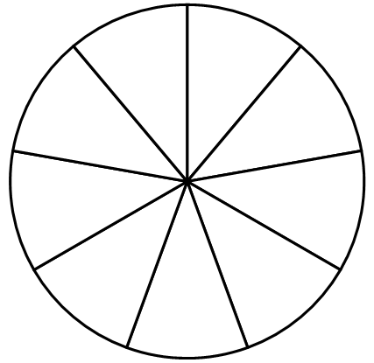
Introduction to pie charts
A headteacher collects information from all students at the school.
The headteacher then represents all this data in a pie chart with 9 sectors.
Each sector represents 20 students.
How many students are at this school?
20
20
20
20
20
20
20
20
20
20 × 9 = 180 students

Slide 11
Introduction to pie charts
A teacher asked a class if they wanted the class noticeboard to be decorated in their favourite colour.
The table show the results.
colour | frequency
yes | 28
no | 16
 | frequency | sectors
total
44 students
11
× 11
one sector
4 students
1
The teacher wants each sector of data to represent 4 students.
How many sectors are needed?
11 sectors

Slide 12

Introduction to pie charts
1) Izzy collects data on whether there was air frost on 150 days between October and February.
The following table of results is represented in a pie chart.
Each sector of the pie chart represents 6 days worth of data. How many sectors should there be altogether?
air frost? | frequency
yes | 24
no | 126
Izzy

Slide 13

Introduction to pie charts
2) Aisha collects data on the number of days that had over 2 hours of sun per day on 160 days between April and September.
The following table of results is represented in a pie chart.
Aisha draws a pie chart. 27 sectors of her pie chart represent the number of days that did have over 2 hours of sunshine. How many sectors does Aisha’s pie chart have in total?
Sunshine over 2 hours? | frequency
yes | 135
no | 25
Aisha

Slide 14
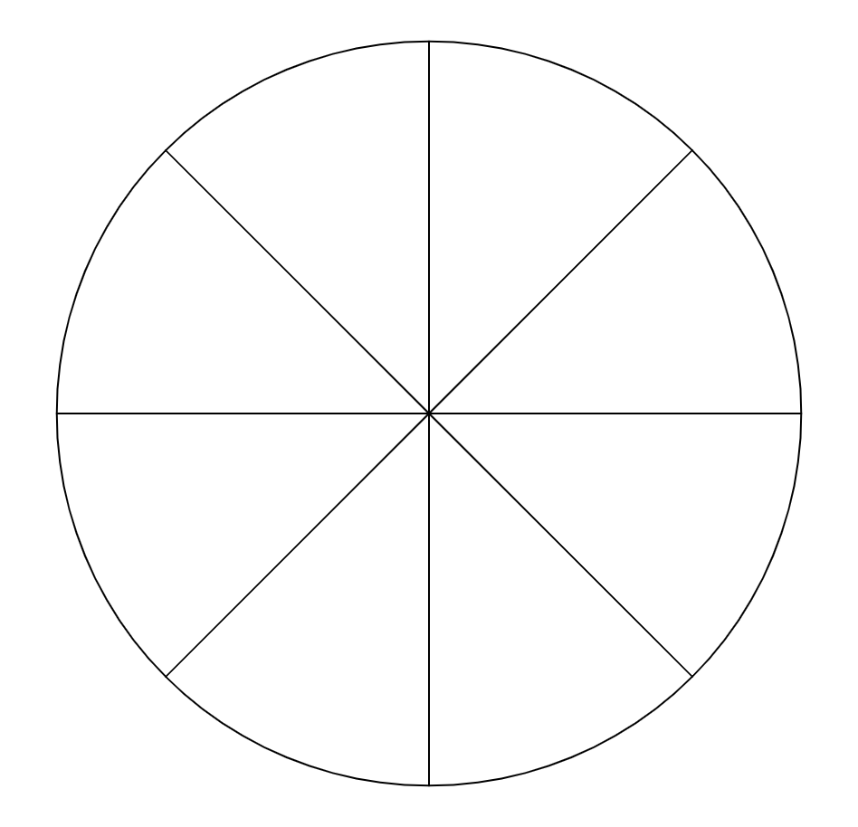

Introduction to pie charts
3) Alex collects data on the number of days in January (31 days) that had snowfall.
Alex wants to represent this data on a pie chart with 8 equal-sized sectors.
a) Explain why it is impossible for Alex to represent this data in a pie chart with 8 equal-sized sectors.
b) Explain whether it is possible for Alex to represent this data in a pie chart with any number of equal-sized sectors.
Alex
snowfall? | frequency
yes | 4
no | 27

Slide 15
Introduction to pie charts
1) Izzy collects data on whether there was air frost on 150 days between October and February.
The following table of results is represented in a pie chart.
Each sector of the pie chart represents 6 days worth of data. How many sectors should there be altogether?
air frost? | frequency
yes | 24
no | 126
Izzy
150 ÷ 6 = 25 sectors

Slide 16
Introduction to pie charts
2) Aisha collects data on the number of days that had over 2 hours of sun per day on 160 days between April and September.
The following table of results is represented in a pie chart.
Aisha draws a pie chart. 27 sectors of her pie chart represent the number of days that did have over 2 hours of sunshine. How many sectors does Aisha’s pie chart have in total?
Sunshine over 2 hours? | frequency
yes | 135
no | 25
Aisha
135 ÷ 27 = 5 days per sector
160 total days ÷ 5 = 32 total sectors

Slide 17
Introduction to pie charts
3) Alex collects data on the number of days in January (31 days) that had snowfall.
Alex wants to represent this data on a pie chart with 8 equal-sized sectors.
a) Explain why it is impossible for Alex to represent this data in a pie chart with 8 equal-sized sectors.
b) Explain whether it is possible for Alex to represent this data in a pie chart with any number of equal-sized sectors.
Alex
snowfall? | frequency
yes | 4
no | 27
31 ÷ 8 does not give an integer answer.
It is only possible if the pie chart is split into a multiple of 31 sectors.

Slide 18
Constructing pie charts
Introduction to pie charts
Calculating angles for pie charts
Constructing pie charts

Slide 19
Calculating angles for pie charts
To draw a pie chart for any set of data (especially larger datasets), we need to start by calculating the angle for each sector. Then you have to:
transport | distance (m)
bike | 11
car | 8
bus | 16
train | 5
1) find the total frequency or total value of your dataset (in this case total distance).
It helps to add this as an extra row to your table.
In this example, the total distance is 11 + 8 + 16 + 5 = 40
total | 40
2) use the fact that a full pie chart contains 360°.

Slide 20
Calculating angles for pie charts
transport | distance (m)
bike | 11
car | 8
bus | 16
train | 5
 | 40
angle
It also helps to draw an extra angles column.
This modifies the frequency table into a ratio table, which allows us to apply proportional reasoning.
total

Slide 21
Calculating angles for pie charts
The total pie chart of 360° represents all 40 pieces of data.
transport | distance (m)
bike | 11
car | 8
bus | 16
train | 5
 | 40
angle
What multiplier links the total distance of 40 to the total angle of 360°?
11 × 9 = 99°
8 × 9 = 72°
16 × 9 = 144°
360 ÷ 40 = 9
5 × 9 = 45°
total
360°
The multiplier is 9.
This means we multiply a distance by 9 to get its associated angle.
Unknown multiplier
× 9
99 + 72 + 144 + 45 = 360°, which confirms it is a full pie chart.

Slide 22
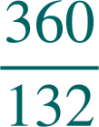



Calculating angles for pie charts
Sometimes the multiplier will be a fraction. It is possible to use division to find the multiplier.
For angles on a pie chart, round to the nearest half degree.
You can’t be more precise than this using your protractor.
fuel-type | frequency
petrol | 60
diesel | 55
electric | 16
other | 1
 | 132
angle
× ≈
163.5°
× =
150°
× ≈
43.5°
× ≈
3°
163.5 + 150 + 43.5 + 3 = 360°.
total
360°
Sometimes if rounding is needed the values won’t sum to exactly 360°, but it should be close.
×
Unknown multiplier

Slide 23


Calculating angles for pie charts
What is always the first step in representing these frequencies as angles on a pie chart?
shopping method | frequency
in store | 32
market | 12
online | 27
mixture | 19
angle
Dividing each number by 360°
a
b
Calculating the total frequency
32 + 12 + 27 + 19 = 90
c
Writing it as a fraction

Slide 24
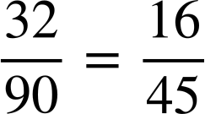
Calculating angles for pie charts
We want to calculate a multiplier that links the total frequency to the total angle in a pie chart, 360°.
Which of these calculations finds the multiplier?
shopping method | frequency
in store | 32
market | 12
online | 27
mixture | 19
 | 90
angle
90 lots of 360° = 90 × 360 = 32400°
a
b
simplify the fraction
c
360° divided by 90 pieces of data
360 ÷ 90 = 4°
total
× 4°=
360°

Slide 25
Calculating angles for pie charts
1) Complete the calculations to represent these frequencies as angles on a pie chart.
2) Complete the calculations to represent these frequencies as angles on a pie chart.
360° ÷ 72 = 5°
360° ÷ = .
weather | frequency | angles
sun | 37
cloud | 22
rain | 13
total | 72 | 360°
meal | cost | angles
breakfast | 12
lunch | 23
dinner | 25
total |  | 360°
× 5
×

Slide 26
Calculating angles for pie charts
3) Complete the calculations to represent these frequencies as angles on a pie chart. Hint: The multiplier is a non-integer.
weather | hours
sun | 40
cloud | 24
rain | 16
total | 80 | 360°
×

Slide 27
Calculating angles for pie charts
1) Complete the calculations to represent these frequencies as angles on a pie chart.
2) Complete the calculations to represent these frequencies as angles on a pie chart.
360° ÷ 72 = 5°
60
6
360° ÷ = .
weather | frequency | angles
sun | 37 | 185
cloud | 22 | 110
rain | 13 | 65
total | 72 | 360°
meal | cost | angles
breakfast | 12 | 72
lunch | 23 | 138
dinner | 25 | 150
total | 60 | 360°
× 5° =
× 5
× 6

Slide 28
Calculating angles for pie charts
3) Complete the calculations to represent these frequencies as angles on a pie chart. Hint: The multiplier is a non-integer.
weather | hours
sun | 40
cloud | 24
rain | 16
total | 80 | 360°
180
108
72
9
_
4.5
=
2
×

Slide 29
Constructing pie charts
Introduction to pie charts
Calculating angles for pie charts
Constructing pie charts

Slide 30
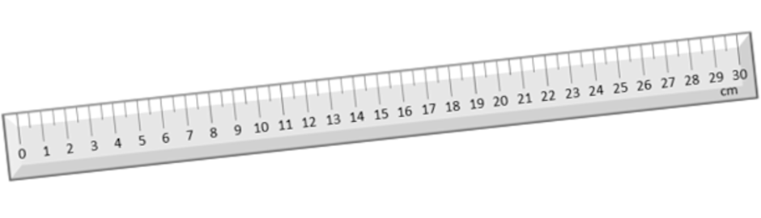
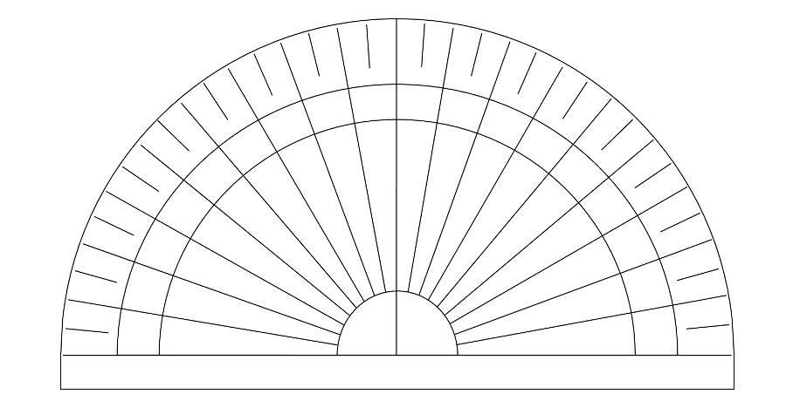
Constructing pie charts
For this part of the lesson, it is essential that you have a:
Before constructing the pie chart, you need a circle with its centre labelled with an x.
ruler
protractor
80°
70°
90°
100°
110°
60°
120°
50°
130°
40°
140°
30°
150°
20°
160°
10°
170°
0°
180°

Slide 31
Constructing pie charts
Let’s first measure an angle of 120 for the purple sector.
Then mark an angle of 120 degrees.
Construct a pie chart with the angles given below.
colour | frequency | angles
purple | 30 | 120°
green | 45 | 180°
blue | 15 | 60°
total | 90 | 360°
Notes:
Take your ruler and draw a line from the centre of the circle until you reach its circumference on the left. Keep your protractor as still as possible. Take your first angle value and find it on your protractor.

Slide 32
Constructing pie charts
Draw a line from the centre of the circle to the marked angle to create the first sector. Label the sector as purple.
colour | frequency | angles
purple | 30 | 120°
green | 45 | 180°
blue | 15 | 60°
total | 90 | 360°
Notes:
Keep your protractor as still as possible.
Take your first angle value and find it on your protractor.

Slide 33
Constructing pie charts
colour | frequency | angles
purple | 30 | 120°
green | 45 | 180°
blue | 15 | 60°
total | 90 | 360°
Now we can plot the green sector by measuring an angle of 180º from the previous line.
Notes:
Overlay the bottom centre of your protractor with the centre of the circle again. But this time, line up the 0° with the most recent line you just drew.
Take your second angle value and find it on your protractor.
Mark that location with a dot or a cross.
Remove the protractor and draw another line from centre to circumference.

Slide 34
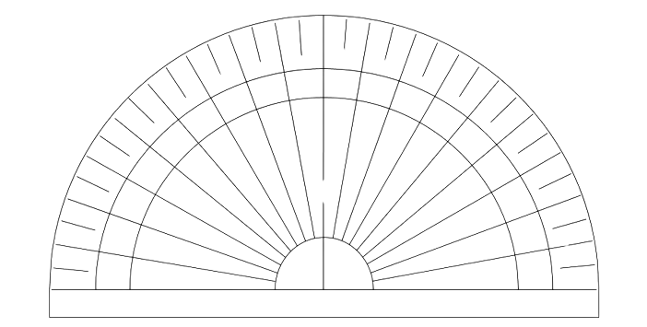
Constructing pie charts
Construct a pie chart with the angles given below.
colour | frequency | angles
purple | 30 | 120°
green | 45 | 180°
blue | 15 | 60°
total | 90 | 360°
80°
70°
90°
100°
110°
60°
120°
purple
50°
130°
40°
140°
30°
150°
20°
160°
10°
170°
0°
180°
Check the final sector by measuring the angle.
The 0° must always line up with the line you just drew – in this case the green line.
blue
green
This angle is 60°, which matches the angle for the blue group.
Notes:
The sector you have created represents the second group of data in the table.
In this example, it is the green group.
Label this sector green. The unlabelled sector should be the correct size for this last group.

Slide 35
Constructing pie charts
Izzy wants to plot the angle of 55°.
Which of these locations is most accurate?
b
c
a
90°
100°
d
80°
70°
110°
60°
120°
50°
130°
40°
140°
30°
150°
20°
160°
Remember to always start at 0° and find your angle clockwise.
10°
170°
0°
180°

Slide 36
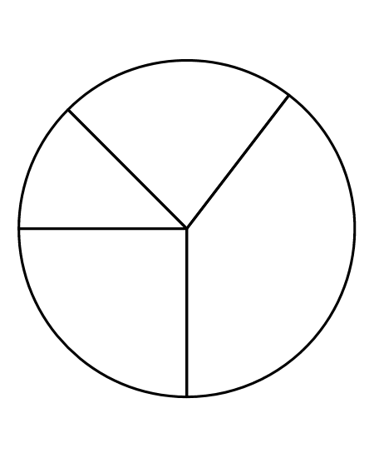
Constructing pie charts
1) The table shows both the frequency and the angles required to represent the data on a pie chart.
The pie chart has been fully constructed, but not labelled.
Label each sector of the pie chart with the correct Key Stage.
Key Stage | Frequency | Angle
KS1 | 72 | 45°
KS2 | 132 | 82.5°
KS3 | 228 | 142.5°
KS4 | 144 | 90°
 | 576 | 360°
total

Slide 37
Constructing pie charts
2) The table shows both the angles required to represent this data on a pie chart.
Construct the pie chart.
Key Stage | Angle
Primary | 180°
Secondary | 75°
College | 105°
 | 360°
total

Slide 38
Constructing pie charts
3) The table shows both the frequency and most of the angles required to represent the data on a pie chart.
Construct the pie chart.
Footwear | Frequency | Angle
Trainers | 42
Boots | 68
Flip-Flops | 10 | 25°
Other | 24 | 60°
 | 144 | 360°
total

Slide 39
Constructing pie charts
1) The table shows both the frequency and the angles required to represent the data on a pie chart.
The pie chart has been fully constructed, but not labelled.
Label each sector of the pie chart with the correct Key Stage.
KS2
KS1
KS3
Key Stage | Frequency | Angle
KS1 | 72 | 45°
KS2 | 132 | 82.5°
KS3 | 228 | 142.5°
KS4 | 144 | 90°
 | 576 | 360°
KS4
total

Slide 40
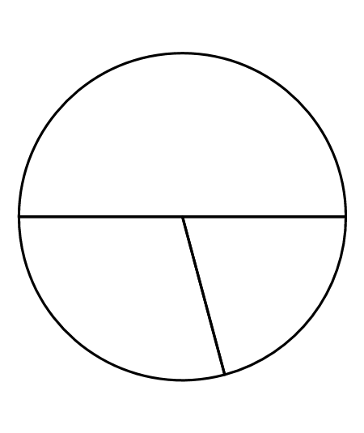
Constructing pie charts
2) The table shows both the angles required to represent this data on a pie chart.
Construct this pie chart.
Primary
College
Secondary
Key Stage | Angle
Primary | 180°
Secondary | 75°
College | 105°
 | 360°
total

Slide 41
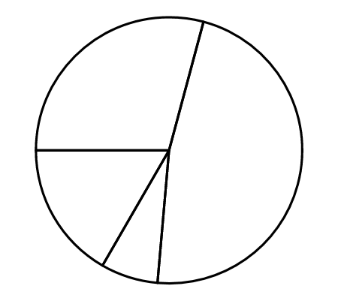
Constructing pie charts
3) The table shows both the frequency and most of the angles required to represent the data on a pie chart.
Construct this pie chart.
Trainers
Boots
Other
Footwear | Frequency | Angle
Trainers | 42 | 105°
Boots | 68 | 170°
Flip-Flops | 10 | 25°
Other | 24 | 60°
 | 144 | 360°
Flip-Flops
total

Slide 42
Constructing pie charts
Pie charts can be constructed by filling in pre-made sectors of a circle proportional to the frequency of data in a dataset.
The angles of a pie chart representing a dataset can be found through proportional reasoning by comparing the total frequencies of the dataset to the total angle of a pie chart, 360°.
A pie chart can be constructed from scratch by using a protractor to measure the angles.

Slide 43

© Oak National Academy 2023.
Produced in partnership with Mathematics in Education and Industry.
Licensed on the Open Government Licence v3.0, except where otherwise stated. See Oak terms and conditions.

